Slide 1
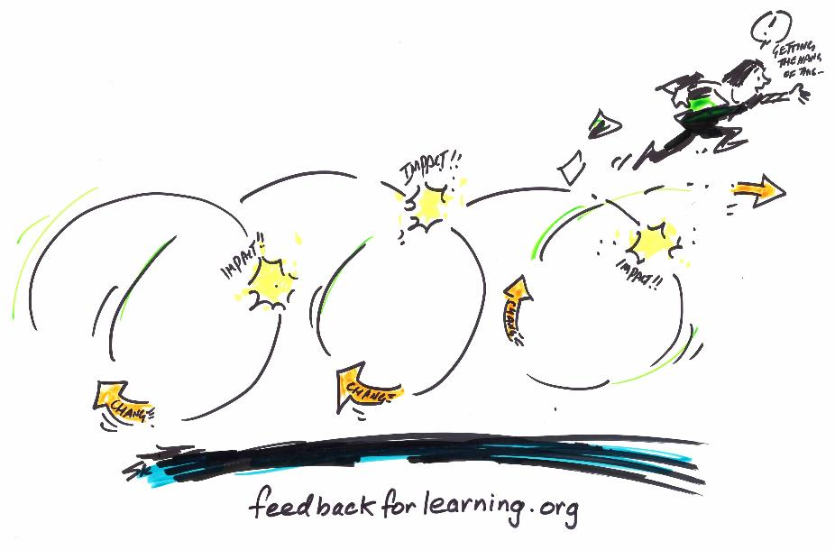




Feedback for Learning: Closing the Assessment Loop
  Presenters
  A/Prof Michael Henderson
  Monash University
  A/Prof Phillip Dawson
  Deakin University
  Online facilitators
  Dr Michael Phillips
  Monash University
  Dr Tracii Ryan
  Monash University
Notes:
Add presenter names for the workshop
REQUIRED: Acknowledgement of funding source (the Office of Learning and Teaching), and project team, led by Michael Henderson (full team details found at project site: feedbackforlearning.org).
This presentation is licensed under the Creative Commons Attribution-ShareAlike 4.0 International License.
Support for this project has been provided by the Australian Government Department of Education and Training. The views expressed in this presentation do not necessarily reflect the views of the Australian Government Department of Education and Training.

Slide 2
Today
Brief intro: project and team
Recap on feedback – what we already know:
  The problem with feedback – why we need to spend time on it
  Conceptions of (effective) feedback
A new definition of feedback (both useful and challenging)
Key findings
  large-scale survey
  seven cases of effective feedback
The Feedback for Learning framework
  A definition with 7 design challenges
  12 Conditions for success, with 40 strategies
Closing the loop
Notes:
[Break - either morning or afternoon tea, depending on workshop time]

Slide 3

Team
Monash
  Associate Professor Michael Henderson
  Dr Michael Phillips
  Dr Tracii Ryan
Deakin
  Professor David Boud
  Associate Professor Phillip Dawson
  Ms Paige Mahoney
Melbourne
  Professor Elizabeth Molloy
Hong Kong University
  Professor David Carless (project evaluator)
Acknowledgement
Support for this project has been provided by the Australian Government Department of Education and Training.
The views expressed in this presentation do not necessarily reflect the views of the Australian Government Department of Education and Training.
License
Unless otherwise noted, content is licensed under the Creative Commons Attribution-ShareAlike 4.0 International License.
Notes:
Acknowledgement: project funding (OLT grant)

Slide 4
The project:
“Feedback for Learning: Closing the Assessment Loop”
Asks “What works, when, and why?” and “What is enabling excellent feedback?”
Takes a social constructivist view of feedback and an ecological perspective on higher education
Conducted a large-scale, mixed-methods study, including identifying cases of effective feedback
Informed by literature and expertise from team, evaluator and reference group
To develop a framework of “conditions for success”
To deliver workshops and reusable materials for the sector
Notes:
Background to the project (left), including rationale for the project, research question, and theoretical lens.
Design of project (right): mixed methods - informed a framework of conditions for successful feedback. Another aim of the project was to develop and deliver workshops (National Roadshow, Sept-Dec 2017). The materials you see today were used as part of this roadshow, and the intention was that educators would be able to use elements as part of their own local professional development initiatives.

Slide 5
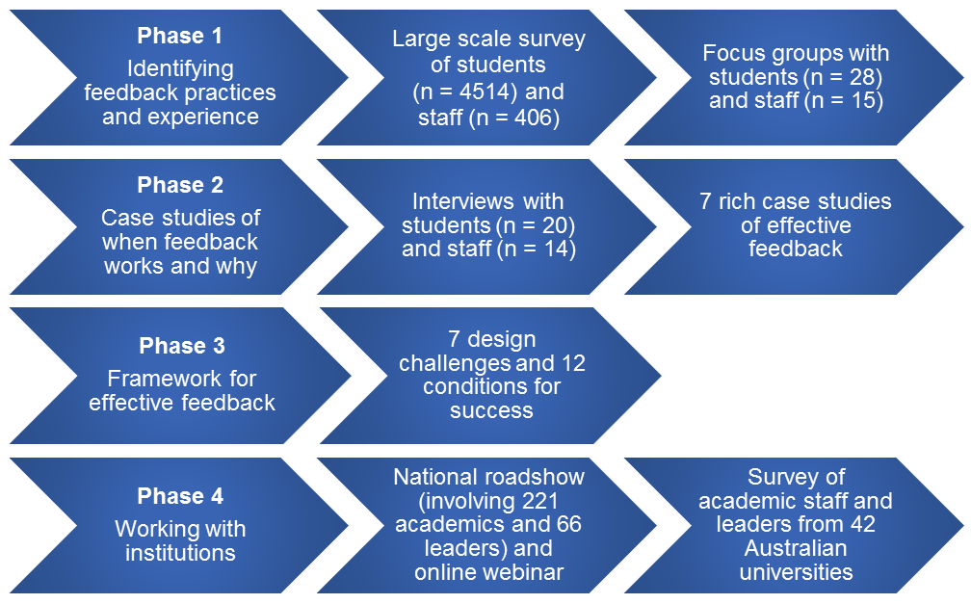
The project:
“Feedback for Learning: Closing the Assessment Loop”
Notes:
The project comprised four phases - outlined as per slide.

Slide 6
The problem with feedback
Learners complain that they do not get enough feedback
Both parties describe it as confronting
Both parties agree that it is very important
Educators resent that although they put considerable time into generating feedback, learners take little notice of it
Educators typically think their feedback is more useful than their learners think
Feedback is typically ‘telling’ and diagnostic in flavour, often lacking strategies for improvement, and often lacking opportunities for further task attempts
Ende 1995; Hattie 2009; Boud & Molloy 2013; Johnson & Molloy 2017
Notes:
This section highlights the problems with feedback, and justifies why we need to think about feedback from another point of view (if we want to generate feedback that makes a difference).
For point six, “diagnostic in flavour” means that, while deficits or strengths in performance are pointed out, strategies for improvement are not provided.

Slide 7
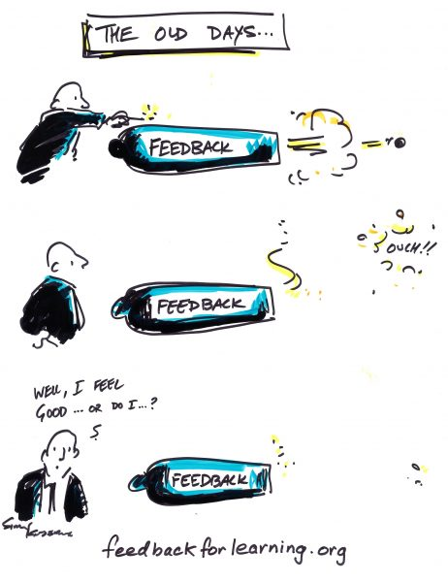
It can be an emotional business
Notes:
Like assessment, feedback is an emotional business.
As shown in this image, it can cause discomfort for both the sender (typically the educator) and the recipient.
Is the sender’s job over once they have sent the information?

Slide 8
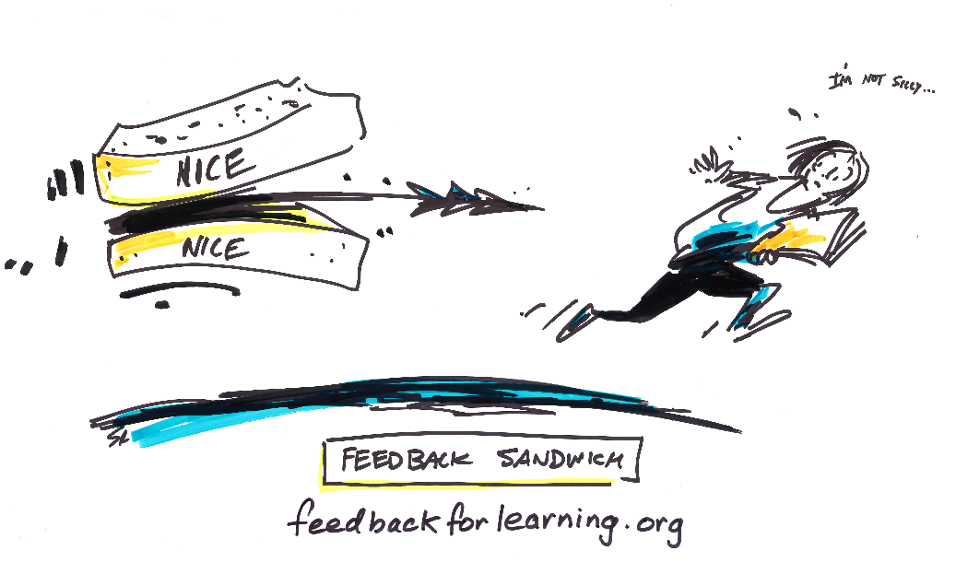
It can be an emotional business
Notes:
Feedback can be emotional for both parties; hence the perceived need for the “feedback sandwich”. This “sandwich”, as depicted here in the slide, is similar to the “sugar-coated pill” in its function – disguising the “negative” feedback, or making it more palatable.
Learners see through the ritual of the feedback sandwich – disregard the positive “bread” and jump straight to the “meat”.
Covered further in E. Molloy, F. Borello, & R. Epstein (2013), Chapter 4: The impact of emotion in feedback, in D. Boud and E. Molloy (eds.) Feedback in Higher Education. Routledge. London. See also Ende (1995).
In anticipating an emotional response from learners, educators can also be ‘mealy-mouthed’ in their feedback, which can interfere with the generation of productive knowledge for both parties. See Ende (1983) for the notion of “vanishing feedback”; Molloy and Boud (2013), Chapter 2 in Boud and Molloy (eds.) Feedback in Higher Education, cover the concept of “mealy-mouthed” approaches to feedback.

Slide 9
Feedback typically underpins the most powerful influences on learning
(Hattie, 2009)
Notes:
So feedback might be difficult and emotional for multiple parties, but it’s worth investing in because it has a strong influence on learning as per Hattie’s (2009) meta-analysis paper.
Feedback in the above study rates at number 10 (with an effect size of 0.73), but Hattie suggests that feedback, as a mechanism, underpins a number of features that are important for learning.

Slide 10
Our definition of effective feedback
“Feedback is a process
in which learners make sense of information
about their performance
and use it
to enhance the quality of their work or learning strategies.”
feedbackforlearning.org
Notes:
The project team’s definition of feedback - devised throughout the project.
The key terms have been emphasised in bold to trigger thoughts from the participants. At this point no need to dissect these points - there is an activity coming up in five slides that unpacks the important components of the definition.
So this is feedback…….

Slide 11

This is not feedback
“I left feedback on their final essays, which they never collected”
Notes:
…and this is not feedback.
An experience that many of us as teachers have experienced.

Slide 12
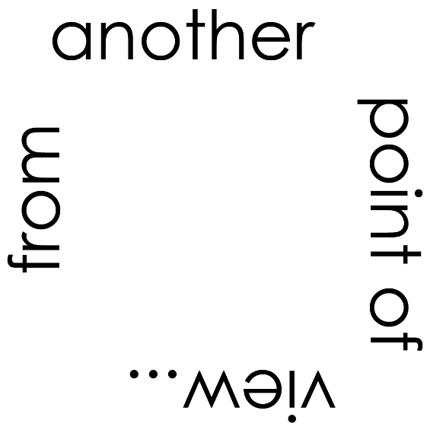
Notes:
Clearly we have a narrow view of what constitutes feedback in education.
Training teachers to “tell better” is not making us better at doing feedback
So, it’s not a matter of trying harder with our same understanding and tools, but looking at things from another point of view.

Slide 13
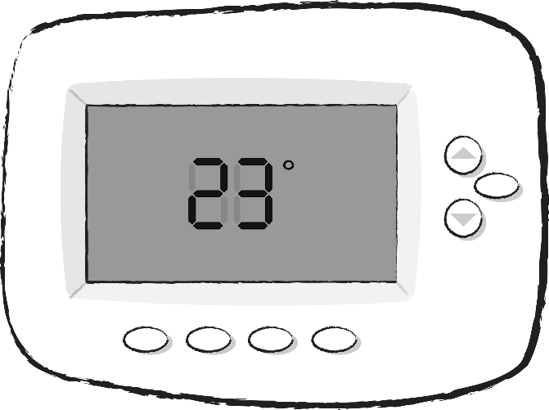
Notes:
But not a new point of view!
Returning to the origins of feedback: biology, with homeostasis, and engineering, with the thermostat.
To take the engineering example, a thermostat in action involves a series of inputs and outputs – there is a closing of the loop. So, there is a set point (let’s say 18 degrees) in the room – like a standard of practice we are aiming for in a program of study. There is input – for example, detecting that the room is 23 degrees. And there is an output – a blast of cool air to bring the temperature to 18 degrees (the set point).
In education, we’ve borrowed this conception but watered it down, and it has lost its potential as a mechanism for “good”.
Without change, “feedback” isn’t feedback – it’s just hopefully useful information

Slide 14
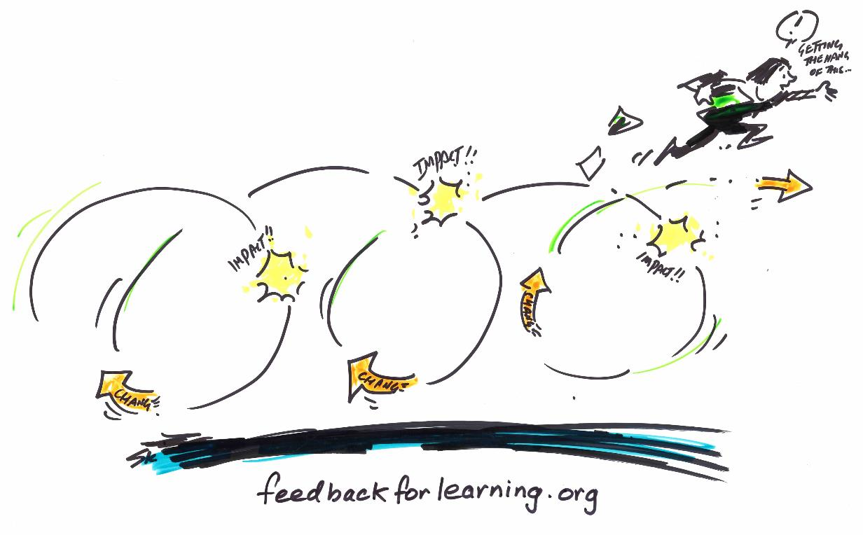
This is feedback
Notes:
A process, enacted over time, with loops.
And a process that results in change in work.

Slide 15
Our definition of effective feedback
“Feedback is a process
in which learners make sense of information
about their performance
and use it
to enhance the quality of their work or learning strategies.”
feedbackforlearning.org
Notes:
Suggested here: an interaction with participants about the challenges inherent in this definition. Which parts are most challenging to them? Use the “framework challenges” on the website to support this conversation.
Process – this definition does not assume that there is “a” single correct strategy.
A challenge in feedback design is that the process is an abstract concept – i.e. the feedback process (sequence, source, frequency, modality, detail, etc.) can look quite different – there is no universal design for that process. In addition, the process may, ideally, be different for each individual.
Learners – this definition is learner-centred.
This represents a shift from a dominant understanding of feedback (comments provided by educators to learners). In this definition, information about performance could come from educators, but it could also be generated by the learner, her/his peers, others, or even automated systems. A challenge in feedback design is to not only facilitate the generation of performance information through these diverse sources, but also to enable learners to make sense of information AND to demonstrate improvement.
Sense-making
A challenge in feedback design is the conceptualisation of the sense-making process. How do we make sense of something? What skills do learners need? What features of the feedback process facilitate effective sense-making?
Information
A challenge in feedback design is the need to consider what nature of information is most useful for learners (e.g. multiple sources, modalities, detailed, personalised, individualised, task oriented, metacognitive/thinking orientated etc.).
Performance
A challenge in feedback design is the concern of whether a single performance is sufficient.
A further challenge is whether the entire performance, or only components, should be the focus of the information.
Because feedback uses performance information to enhance future work and learning strategies, it is logical that there should be more feedback opportunities earlier in a subject (front-end loading). But how can we have more feedback earlier, without also assessing more?
Some prompts for facilitators:
It is a process extended over time and is not a single act of “reception of information”.
It centres on learners and what they do, rather than what teachers or other parties others do for them.
It recognises the importance of standards applicable to work produced and the need for learners to understand what these are (making sense).
It positions feedback as leading to action (work or learning strategies) as a necessary part of the process.

Slide 16
Design challenges
Process
Learners
Information
Performance
Sense making
Effect/Impact
Quality
http://feedbackforlearning.org/framework-of-effective-feedback/definition
Notes:
There are several challenges inherent in this definition.
http://newmediaresearch.educ.monash.edu.au/feedback/framework-of-effective-feedback/definition/
Process: There is no universal approach for feedback that works in all contexts; a key challenge in feedback is creating feedback processes that effectively uses different sequences, sources, modalities, and so on.
Learners: Rather than focusing on comments, this definition focuses on what learners do. In this definition, information about performance could come from educators, but it could also be generated by the learner, her/his peers, others or even automated systems.
Sense making: A challenge in feedback design is the conceptualisation of the sense making process. How do we make sense of something? What skills do learners need? What features of the feedback process facilitate effective sense-making?
Information: What sort of information is most useful for learners (e.g., multiple sources, modalities, detailed, personalised, individualised, task oriented, metacognitive/thinking orientated, etc.)
Performance: Is a single performance sufficient? Should feedback focus on the entire performance, or only components? How can we have more early feedback opportunities without assessing more?
Effect/impact: How do educators or students know if feedback has an effect? A challenge in feedback design is to set the conditions in which learners have opportunities to demonstrate improvement which is more than simply asking them to do a further task. It necessarily needs to also offer a chance for learners to judge their performance and evaluate it in relation to their changed work/learning strategies.
Quality: Feedback information needs to be targeted towards improvement, but against what benchmark? In a criterion-referenced or standards-based system, comments on student work need to relate to explicit task expectations, however expert understandings of quality are often tacit or hard to describe.

Slide 17
A key challenge: process
(Comments are not enough)
Quality of comments matter, but they aren’t the only important piece
Think of feedback as a degustation
  Ingredients
  Appetite
  Sequencing of courses
  Nutrition
  Allergies
Notes:
Very often, students and teachers think of feedback as comments.
But it is a much more complex process – think of feedback as like preparing a degustation. There is a list of multiple considerations – and it’s the way you put these together that is important.
Nutrition: feedback that allows students to grow (vs. what they want). E.g. eating Cheezels might feel good, but there is no nutritional value.
Allergies: check for guest allergies (feedback literacy - including past experiences with feedback).

Slide 18
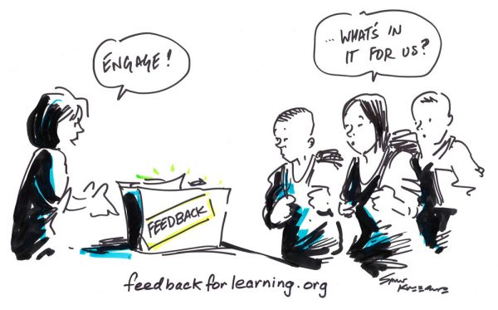
Process:
It needs to have an effect for learners to engage
Notes:
Ultimately, no amount of telling learners that feedback is important is going to make them engage,
Feedback needs to have an effect, in order for learners to engage/invest.

Slide 19
Evolution of feedback designs: Mark 0
Hopefully useful information
Given/done to receivers
  “The professor gave feedback to the student”
Provided on completion of work
Boud & Molloy 2013
Notes:
In the literature, Boud and Molloy (2013) discuss the evolution of feedback frameworks.
Feedback Mark 0 is what we are currently doing (in the main) – that is, “delivering hopefully useful information”. We say “hopefully” because we cross our fingers and wish that it has an effect (we don’t monitor for the effect).

Slide 20
Evolution of feedback designs: Mark 1
More than hopefully useful information - looking for effect
Given/done to receivers
Sequenced to require improvement
Given in time to allow for improved work
Notes:
Feedback Mark 1 represents a shift in the right direction.
It acknowledges that looking for effect is a necessary part of the process.
Can use the thermostat metaphor as an example to elaborate on point one (looking for effect).

Slide 21
Feedback Mark 1: looking for effect
Notes:
In Feedback Mark 1, students have opportunities to incorporate new strategies into practice AND educators are able to monitor the effect of their comments (to calibrate their own feedback practices).
Another premise of the task design is that Activity 2 must be somehow related to Activity 1, in order to show an effect. See the next slide for an illustration of these overlapping learning outcomes within sequenced tasks.

Slide 22
Feedback Mark 1: iterative task design
Activity 3
Activity 2
Activity 1
Overlap of learning outcomes
Degree of
task
challenge
Overlap of learning outcomes
Time
Molloy & Boud 2013
Notes:
The x axis is time, and the y axis represents degree of task challenge.
You can see the overlapping of learning outcomes, which means that students have a chance to improve elements of work that were commented upon in the earlier task.

Slide 23
Evolution of feedback designs: Mark 2
Feedback Mark 1 (importance of effect) plus:
  Dialogic
  Participatory and agentic (students are not just objects)
  Others instead of experts
  Development of evaluative judgement
Notes:
So Feedback Mark 1 is an improvement on Feedback Mark 0, but it’s not good enough to represent the goals of feedback practice in Higher Education.
And that is because students are not like machines (e.g. thermostats or steam engines) and they do not respond in predictable ways to a stimulus.
Student have volition, and they bring with them all types of experiences, prior knowledge and preferences that mean they engage with new knowledge differently.
Feedback Mark 2, as a model, accounts for the fact that students are not machines.
The model uses the important principles from Feedback Mark 1 (importance of effect), and it privileges other aspects – as per the four dot points.

Slide 24
Feedback Mark 2
An example
Orientation to standards of work & purpose of feedback
Activity 1
Learner judges work
Learner asks for specific feedback
Others judge work
Compare judgements
Plan for improved work
Activity 2
Notes:
Run through the key elements of Feedback Mark 2 (using laser pointer).
The learner has the tough job of “comparing judgements” (their own evaluative judgement with the opinions of others) – and then needs to come up with a plan for improved work.
As in Feedback Mark 1, there needs to be a second activity set up for learners so that the feedback can have an effect.

Slide 25
Summary of messages from the literature
Feedback can be powerful
Feedback is rarely powerful
Feedback is not an input but rather a process, so a focus on feedback design is needed
Feedback needs to be judged in terms of OUTCOMES
Notes:
Point four – quality of feedback is judged on learner outcomes (this is the test of quality).

Slide 26
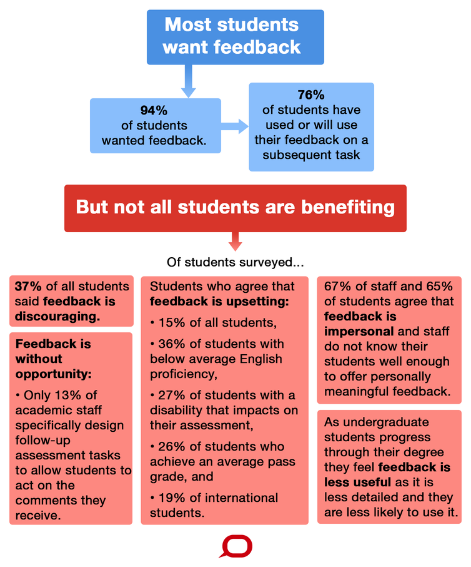
Survey
The Conversation, CC BY-ND
https://theconversation.com/universities-are-failing-their-students-through-poor-feedback-practices-86756

Slide 27
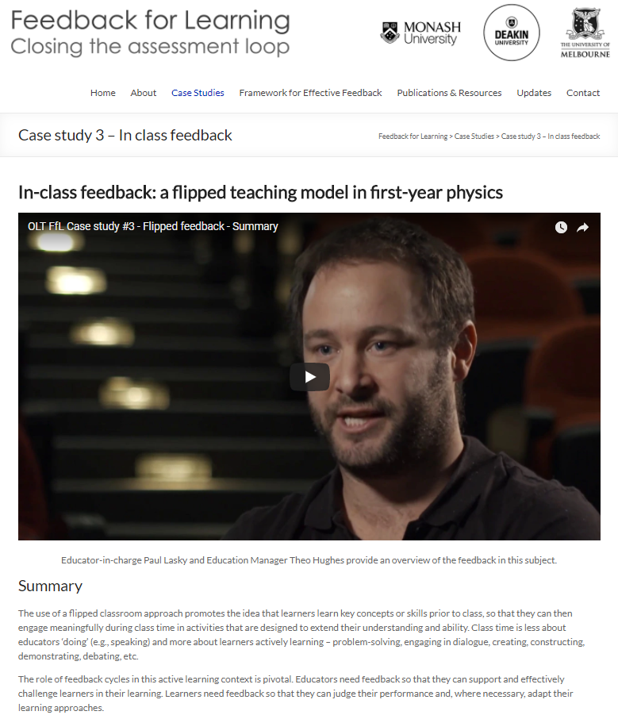
Cases of effective feedback
Development:
  Surveys and focus groups with educators and students identified cases where feedback was working well.
  In-depth interviews with multiple teaching staff and students to understand what is working well and why.
Cases:
  useful exemplars of effective feedback
  but also valued for the lessons learnt in enabling feedback.
http://feedbackforlearning.org/case-studies-of-effective-feedback/
Notes:
From the survey - the project team identified good examples of feedback (multiple references by both students and educators - and relative to unit size).
All moderately large class sizes.
We sought out people who had interesting or good feedback designs.
Graphic has a hyperlink to project website. Navigate to ‘Feedback Possibilities’ then ‘Case Studies of Effective Feedback’.
For our workshops we showed a two-minute video with Jacqui Broadbent (recent national teaching award winner), from Case 2. You might use her case or choose a different case study to reflect features you would like to showcase.
The cases are not just shiny things that work - we’ve worked to dissect the features that help to make them effective.
We’ve talked to staff and students.
And looked at artefacts/materials.
Scroll through the seven cases. Participants are encouraged to explore in their own time.

Slide 28
Cases of effective feedback
Developmental and diverse feedback: helping first-year learners to transition into higher education
Personalised feedback at scale: Moderating audio feedback in first-year psychology
In-class feedback: a flipped teaching model in first-year physics
Authentic feedback through social media in second year digital media
Layers and loops: scaffolding feedback opportunities in first-year biology
Multiple prompt strategies across contexts: feedback in classroom, lab and professional practice
Investing in educators: enhancing feedback practices through the development of strong tutoring teams
http://feedbackforlearning.org/case-studies-of-effective-feedback/

Slide 29
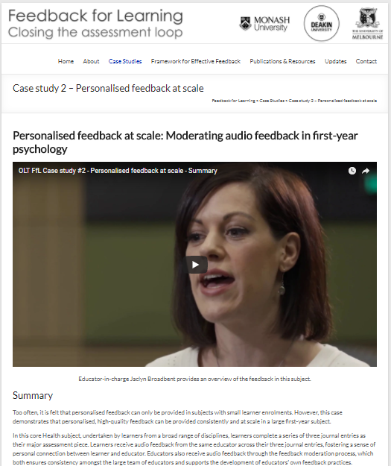
Case study 2 – Personalised feedback at scale
Cases of effective feedback
Summary
Case description (what they did)
Why it worked
  The design
  Enablers
  Challenges
  Links with the literature
Moving forwards
  Advice to educators
  Advice to institutions
  Resources
http://feedbackforlearning.org/case-studies-of-effective-feedback/
Notes:
From the survey - the project team identified good examples of feedback (multiple references by both students and educators - and relative to unit size).
All moderately large class sizes.
We sought out people who had interesting or good feedback designs.
Graphic has a hyperlink to project website. Navigate to ‘Feedback Possibilities’ then ‘Case Studies of Effective Feedback’.
For our workshops we showed a two-minute video with Jacqui Broadbent (recent national teaching award winner), from Case 2. You might use her case or choose a different case study to reflect features you would like to showcase.
The cases are not just shiny things that work - we’ve worked to dissect the features that help to make them effective.
We’ve talked to staff and students.
And looked at artefacts/materials.
Scroll through the seven cases. Participants are encouraged to explore in their own time.

Slide 30

Framework: What enables successful feedback?
The cases were analysed to identify key factors that enabled successful feedback. Cases were compared and twelve conditions emerged as enablers across multiple cases , which we have clustered into three key themes.
Notes:
As well as the Definition and Challenges, the framework contains three layers:
- Three categories – capacity, designs and culture
- Four conditions in each category (twelve overall)
- Strategies associated with each conditions, drawn from each case study and reflecting real-world practices

Slide 31
Framework: What enables successful feedback?
The resulting framework is made up of:
  A definition of effective feedback
    7 design challenges arising from the definition
  Twelve conditions for effective feedback, clustered according to themes of: capacity, designs and culture.
    Forty strategies or examples drawn from the case studies that illustrate how the conditions were met in those cases.
Notes:
As well as the Definition and Challenges, the framework contains three layers:
- Three categories – capacity, designs and culture
- Four conditions in each category (twelve overall)
- Strategies associated with each conditions, drawn from each case study and reflecting real-world practices

Slide 32


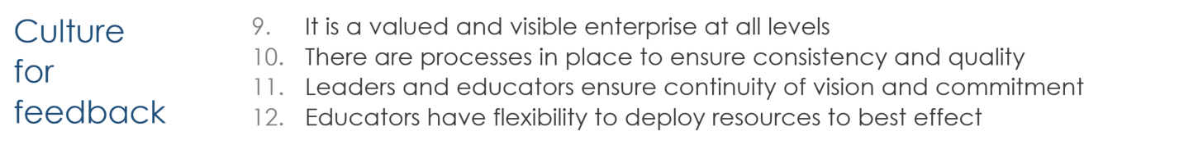
Framework: What enables successful feedback?
http://newmediaresearch.educ.monash.edu.au/feedback/framework-of-effective-feedback/conditions-for-success/

Slide 33
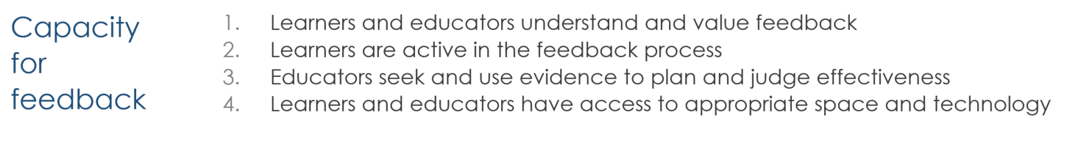

Framework: What enables successful feedback?
http://newmediaresearch.educ.monash.edu.au/feedback/framework-of-effective-feedback/conditions-for-success/

Slide 34

Framework: What enables successful feedback?
http://newmediaresearch.educ.monash.edu.au/feedback/framework-of-effective-feedback/conditions-for-success/

Slide 35
Framework: What enables successful feedback?
http://newmediaresearch.educ.monash.edu.au/feedback/framework-of-effective-feedback/conditions-for-success/

Slide 36
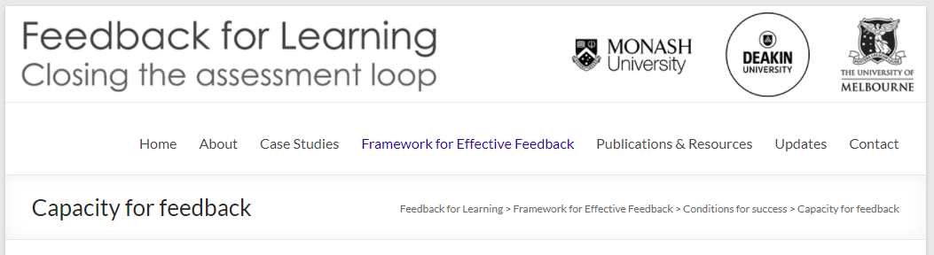
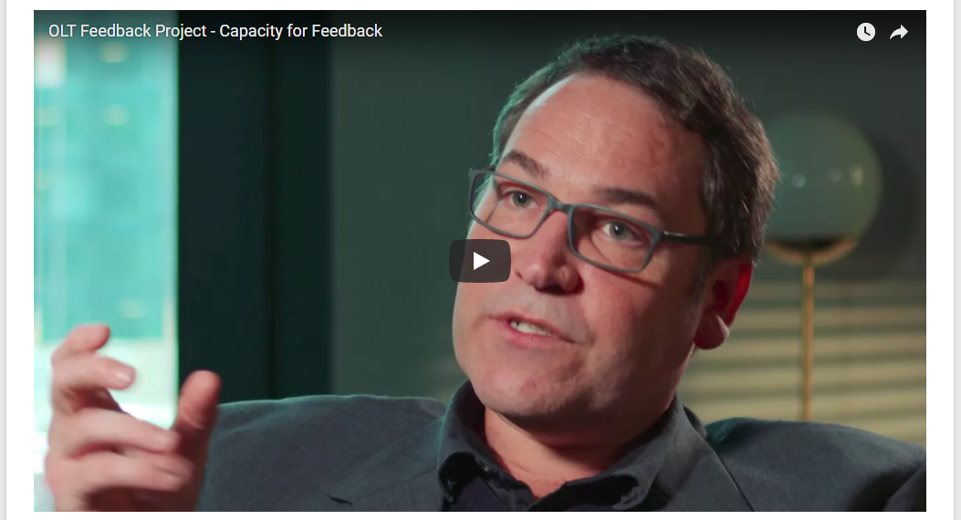
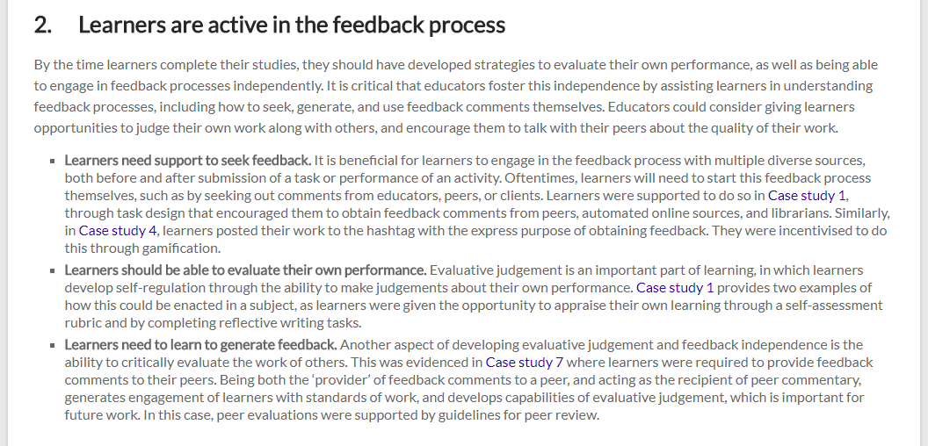
Taking a closer look
Diving into one condition as an example.
Learners are active in the feedback process
By the time learners complete their studies, they should have developed strategies to evaluate their own performance, as well as being able to engage in feedback processes independently.
  Learners need support to seek feedback.
  Learners should be able to evaluate their own performance
  Learners need to learn to generate feedback
http://newmediaresearch.educ.monash.edu.au/feedback/framework-of-effective-feedback/conditions-for-success/capacity-for-feedback/
Notes:
2. Learners are active in the feedback process
By the time learners complete their studies, they should have developed strategies to evaluate their own performance, as well as being able to engage in feedback processes independently. It is critical that educators foster this independence by assisting learners in understanding feedback processes, including how to seek, generate, and use feedback comments themselves. Educators could consider giving learners opportunities to judge their own work along with others, and encourage them to talk with their peers about the quality of their work.
Learners need support to seek feedback. It is beneficial for learners to engage in the feedback process with multiple diverse sources, both before and after submission of a task or performance of an activity. Oftentimes, learners will need to start this feedback process themselves, such as by seeking out comments from educators, peers, or clients. Learners were supported to do so in Case study 1, through task design that encouraged them to obtain feedback comments from peers, automated online sources, and librarians. Similarly, in Case study 4, learners posted their work to the hashtag with the express purpose of obtaining feedback. They were incentivised to do this through gamification.
Learners should be able to evaluate their own performance. Evaluative judgement is an important part of learning, in which learners develop self-regulation through the ability to make judgements about their own performance. Case study 1 provides two examples of how this could be enacted in a subject, as learners were given the opportunity to appraise their own learning through a self-assessment rubric and by completing reflective writing tasks.
Learners need to learn to generate feedback. Another aspect of developing evaluative judgement and feedback independence is the ability to critically evaluate the work of others. This was evidenced in Case study 7 where learners were required to provide feedback comments to their peers. Being both the ‘provider’ of feedback comments to a peer, and acting as the recipient of peer commentary, generates engagement of learners with standards of work, and develops capabilities of evaluative judgement, which is important for future work. In this case, peer evaluations were supported by guidelines for peer review.

Slide 37
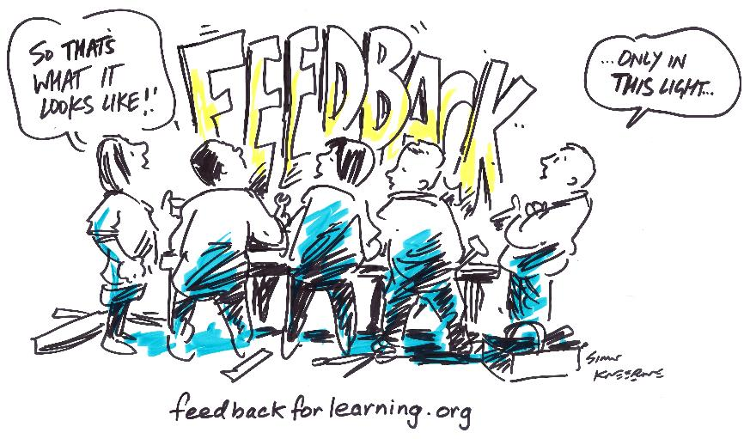

Slide 38
Summary: closing the loop
Next steps for us!
  Disseminating findings
  Exploring strategies – particularly in relation to the challenges
  Working with partners – nationally and internationally
  Monitoring impact
Next steps for you!
  What are you going to do?
  What will you do to effect change in your department/context/program?
  How can this project and its resources support your work?
Notes:
Ask for participant responses re: their take-home messages from the workshop - and their own goals when it comes to improving feedback. It can be useful for participants to write down a key goal and take this away with them (helps form a sense of commitment).
A reminder to visit the feedbackforlearning.org website to access resources.
(NB: the Feedback for Learning Framework includes the definition, as well as conditions for success.)

Slide 39
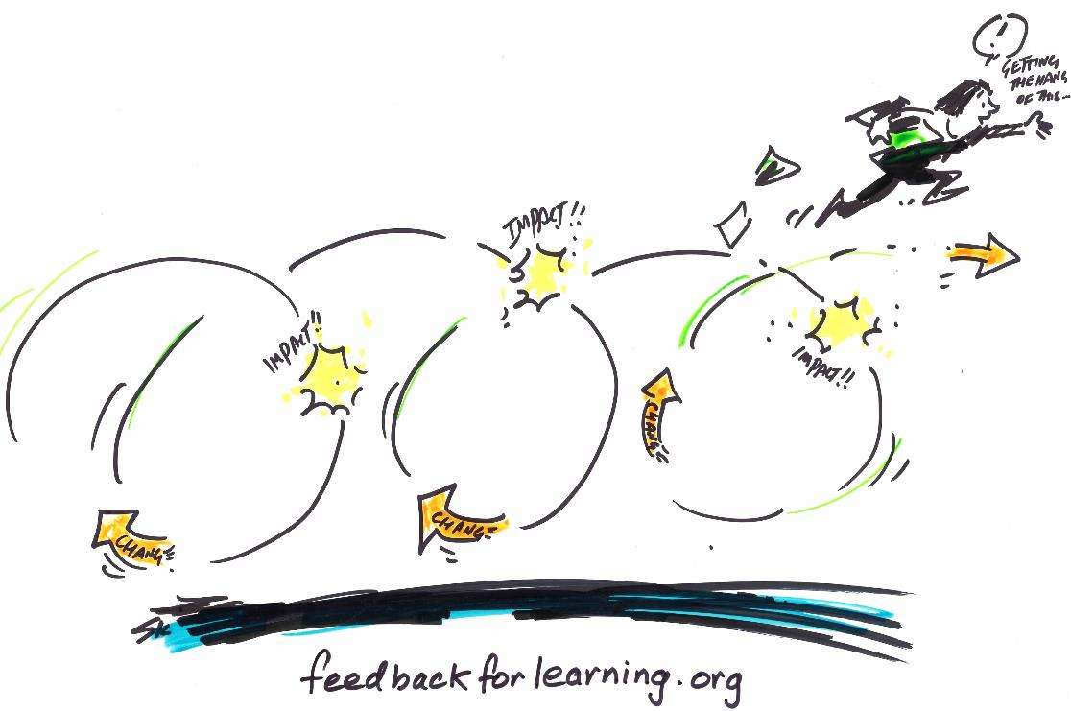
Notes:
Closing image to capture the notion that “feedback that has an effect”.

Slide 40
References
Boud, D., & Molloy, E. (2013). Rethinking models of feedback for learning: the challenge of design. Assessment & Evaluation in Higher Education, 38. doi:10.1080/02602938.2012.691462
Boud D & Molloy E (Eds.) (2013b) Feedback in Higher and Professional Education . London: Routledge.
Dawson, P. (2017). Assessment rubrics: towards clearer and more replicable design, research and practice. Assessment & Evaluation in Higher Education, 42(3), 347-360. doi:10.1080/02602938.2015.1111294
Dawson, P., Bearman, M., Boud, D. J., Hall, M., Molloy, E. K., Bennett, S., & Joughin, G. (2013). Assessment might dictate the curriculum, but what dictates assessment?. Teaching and Learning Inquiry: The ISSOTL Journal, 1(1), 107-111.
Ende, J., Pomerantz, A. & Erickson, F. (1995): Preceptors' strategies for correcting residents in an ambulatory care medicine setting: A qualitative analysis. Academic Medicine 70: 224-229
Hattie, J. (2009). The black box of tertiary assessment: An impending revolution. In L. H. Meyer, S. Davidson, H. Anderson, R. Fletcher, P. M. Johnston, & M. Rees (Eds.), Tertiary Assessment & Higher Education Student Outcomes: Policy, Practice & Research. Wellington, New Zealand: Ako Aotearoa.
Johnson C, Keating J, Boud D, Dalton M, Kiegaldie D, Hay M, McGrath B, McKenzie W, Nair K, Nestel D, Palermo C, Molloy E (2016) Identifying educator behaviours for high quality verbal feedback in health professions education: literature review and expert refinement. BMC Medical Educationm DOI: 10.1186/s12909-016-0613-5 URL: http://www.biomedcentral.com/1472-6920/16/96.
Molloy E (2009): Time to Pause: Giving and Receiving Feedback in Clinical Education. Chapter 8 in Clinical Education in the Health Professions, Sydney: Elsevier: p. 128- 146

Slide 41
References
Price, M., Carroll, J., O'Donovan, B., & Rust, C. (2011). If I was going there I wouldn't start from here: a critical commentary on current assessment practice. Assessment & Evaluation in Higher Education, 36(4), 479-492. doi: 10.1080/02602930903512883
Sadler, D. R. (2013). Assuring academic achievement standards: from moderation to calibration. Assessment in Education: Principles, Policy & Practice, 20(1), 5-19. doi:10.1080/0969594X.2012.714742
Tai, J. H.-M., Canny, B. J., Haines, T. P., & Molloy, E. K. (2016). The role of peer-assisted learning in building evaluative judgement: opportunities in clinical medical education. Advances in Health Sciences Education, 21(3), 659-676. doi:10.1007/s10459-015-9659-0
Watling, C., Driessen, E., van der Vleuten, C. P. M., Vanstone, M., & Lingard, L. (2012). Understanding responses to feedback: the potential and limitations of regulatory focus theory. Medical Education, 46(6), 593-603. doi:10.1111/j.1365-2923.2012.04209.x
Winstone, N. E., Nash, R. A., Parker, M., & Rowntree, J. (2017). Supporting Learners' Agentic Engagement With Feedback: A Systematic Review and a Taxonomy of Recipience Processes. Educational Psychologist, 52(1), 17-37. doi:10.1080/00461520.2016.1207538
Winstone, N. E., Nash, R. A., Rowntree, J., & Menezes, R. (2016). What do students want most from written feedback information? Distinguishing necessities from luxuries using a budgeting methodology. Assessment & Evaluation in Higher Education, 41(8), 1237-1253. doi:10.1080/02602938.2015.1075956
Illustrations by Simon Kneebone for the Feedback for Learning OLT Project (CC BY-SA 4.0)

Slide 42
Contacts
Project contact page: feedbackforlearning.org/feedback/contact/
  michael.henderson@monash.edu
  michael.phillips@monash.edu
  tracii.ryan@monash.edu
  elizabeth.molloy@unimelb.edu.au
  david.boud@deakin.edu.au
  p.dawson@deakin.edu.au
  p.mahoney@deakin.edu.au
  dcarless@hku.hk

